Slide 1
Chapter 11 – Strings and Characters
Outline
11.1 Introduction
11.2 Fundamentals of Characters and Strings
11.3 Class String
11.3.1 String Constructors
11.3.2 String Methods length, charAt and getChars
11.3.3 Comparing Strings
11.3.4 Locating Characters and Substrings in Strings
11.3.5 Extracting Substrings from Strings
11.3.6 Concatenating Strings
11.3.7 Miscellaneous String Methods
11.3.8 String Method valueOf
11.4 Class StringBuffer
11.4.1 StringBuffer Constructors
11.4.2 StringBuffer Methods length, capacity, setLength and ensureCapacity
11.4.3 StringBuffer Methods charAt, setCharAt, getChars and reverse

Slide 2
Chapter 11 – Strings and Characters
11.4.4 StringBuffer append Methods
11.4.5 StringBuffer Insertion and Deletion Methods
11.5 Class Character
11.6 Class StringTokenizer

Slide 3
11.1 Introduction
String and character processing
  Class java.lang.String
  Class java.lang.StringBuffer
  Class java.lang.Character
  Class java.util.StringTokenizer

Slide 4
11.2 Fundamentals of Characters and Strings
Characters
  “Building blocks” of non-numeric data
  ’a’, ’$’, ’4’
String
  Sequence of characters treated as single unit
  May include letters, digits, etc.
  Object of class String
  String name = “Frank N. Stein”;

Slide 5
11.3.1 String Constructors
Class String
  Provides nine constructors
  Null constructor String() has no characters and a length of zero
  String (array, offset, number of characters)

Slide 6
StringConstructors.java
Line 17
Line 18
Line 19
Line 20
Line 21
Line 22
1 // Fig. 11.1: StringConstructors.java
2 // String class constructors.
3 import javax.swing.*;
4
5 public class StringConstructors {
6
7 public static void main( String args[] )
8 {
9 char charArray[] = { 'b', 'i', 'r', 't', 'h', ' ', 'd', 'a', 'y' };
10 byte byteArray[] = { ( byte ) 'n', ( byte ) 'e',
11 ( byte ) 'w', ( byte ) ' ', ( byte ) 'y',
12 ( byte ) 'e', ( byte ) 'a', ( byte ) 'r' };
13
14 String s = new String( "hello" );
15
16 // use String constructors
17 String s1 = new String( );
18 String s2 = new String( s );
19 String s3 = new String( charArray );
20 String s4 = new String( charArray, 6, 3 );
21 String s5 = new String( byteArray, 4, 4 );
22 String s6 = new String( byteArray );
String default constructor instantiates empty string
Constructor copies String
Constructor copies character array
Constructor copies character-array subset
Constructor copies byte-array subset
Constructor copies byte array

Slide 7
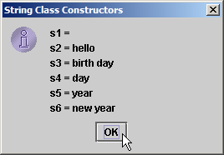
StringConstructors.java
23
24 // append Strings to output
25 String output = "s1 = " + s1 + "\ns2 = " + s2 + "\ns3 = " + s3 +
26 "\ns4 = " + s4 + "\ns5 = " + s5 + "\ns6 = " + s6;
27
28 JOptionPane.showMessageDialog( null, output,
29 "String Class Constructors", JOptionPane.INFORMATION_MESSAGE );
30
31 System.exit( 0 );
32 }
33
34 } // end class StringConstructors

Slide 8
11.3.2 String Methods length, charAt and getChars
Method length
  Determine String length
    Like arrays, Strings always “know” their size
    Unlike array, Strings do not have length instance variable
    s1.length()
Method charAt
  Get character at specific location in String
  s1.charAt( offset )
Method getChars
  Get entire set of characters in String
  s1.getChars( start, first after, charArray, start );

Slide 9
StringMiscellaneous.java
Line 16
Line 21
1 // Fig. 11.2: StringMiscellaneous.java
2 // This program demonstrates the length, charAt and getChars
3 // methods of the String class.
4 import javax.swing.*;
5
6 public class StringMiscellaneous {
7
8 public static void main( String args[] )
9 {
10 String s1 = "hello there";
11 char charArray[] = new char[ 5 ];
12
13 String output = "s1: " + s1;
14
15 // test length method
16 output += "\nLength of s1: " + s1.length();
17
18 // loop through characters in s1 and display reversed
19 output += "\nThe string reversed is: ";
20
21 for ( int count = s1.length() - 1; count >= 0; count-- )
22 output += s1.charAt( count ) + " ";
Determine number of characters in String s1
Append s1’s characters in reverse order to String output

Slide 10
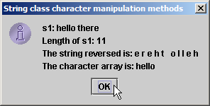
StringMiscellaneous.java
Line 25
23
24 // copy characters from string into charArray
25 s1.getChars( 0, 5, charArray, 0 );
26 output += "\nThe character array is: ";
27
28 for ( int count = 0; count < charArray.length; count++ )
29 output += charArray[ count ];
30
31 JOptionPane.showMessageDialog( null, output,
32 "String class character manipulation methods",
33 JOptionPane.INFORMATION_MESSAGE );
34
35 System.exit( 0 );
36 }
37
38 } // end class StringMiscellaneous
Copy (some of) s1’s characters to charArray

Slide 11
11.3.3 Comparing Strings
Comparing String objects
  Should not use == (true only if the strings are at the same address, i.e., same string)
  Primitives contain values, objects contain addresses
  Method equals (true if the strings are identical)
  Method equalsIgnoreCase
  Method compareTo
    a.compareTo(b), 0 if a and b are same, negative if a<b, positive if a>b
  Method regionMatches
    a.regionMatches(start, b, start, num of chars) (true if the strings are identical)

Slide 12
StringCompare.java
Line 18
Line 24
1 // Fig. 11.3: StringCompare.java
2 // String methods equals, equalsIgnoreCase, compareTo and regionMatches.
3 import javax.swing.JOptionPane;
4
5 public class StringCompare {
6
7 public static void main( String args[] )
8 {
9 String s1 = new String( "hello" ); // s1 is a copy of "hello"
10 String s2 = "goodbye";
11 String s3 = "Happy Birthday";
12 String s4 = "happy birthday";
13
14 String output = "s1 = " + s1 + "\ns2 = " + s2 + "\ns3 = " + s3 +
15 "\ns4 = " + s4 + "\n\n";
16
17 // test for equality
18 if ( s1.equals( "hello" ) ) // true
19 output += "s1 equals \"hello\"\n";
20 else
21 output += "s1 does not equal \"hello\"\n";
22
23 // test for equality with ==
24 if ( s1 == "hello" ) // false; they are not the same object
25 output += "s1 equals \"hello\"\n";
26 else
27 output += "s1 does not equal \"hello\"\n";
Method equals tests two objects for equality using lexicographical comparison
Equality operator (==) tests if both references refer to same object in memory

Slide 13
StringCompare.java
Line 30
Lines 36-40
Line 43 and 49
28
29 // test for equality (ignore case)
30 if ( s3.equalsIgnoreCase( s4 ) ) // true
31 output += "s3 equals s4\n";
32 else
33 output += "s3 does not equal s4\n";
34
35 // test compareTo
36 output += "\ns1.compareTo( s2 ) is " + s1.compareTo( s2 ) +
37 "\ns2.compareTo( s1 ) is " + s2.compareTo( s1 ) +
38 "\ns1.compareTo( s1 ) is " + s1.compareTo( s1 ) +
39 "\ns3.compareTo( s4 ) is " + s3.compareTo( s4 ) +
40 "\ns4.compareTo( s3 ) is " + s4.compareTo( s3 ) + "\n\n";
41
42 // test regionMatches (case sensitive)
43 if ( s3.regionMatches( 0, s4, 0, 5 ) )
44 output += "First 5 characters of s3 and s4 match\n";
45 else
46 output += "First 5 characters of s3 and s4 do not match\n";
47
48 // test regionMatches (ignore case)
49 if ( s3.regionMatches( true, 0, s4, 0, 5 ) )
50 output += "First 5 characters of s3 and s4 match";
51 else
52 output += "First 5 characters of s3 and s4 do not match";
Test two objects for equality, but ignore case of letters in Strings
Method compareTo compares String objects
Method regionMatches compares portions of two String objects for equality

Slide 14
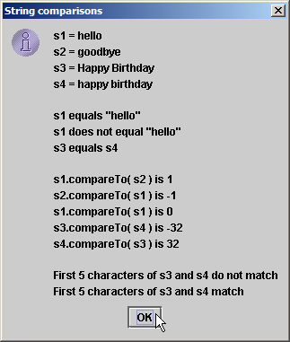
StringCompare.java
53
54 JOptionPane.showMessageDialog( null, output,
55 "String comparisons", JOptionPane.INFORMATION_MESSAGE );
56
57 System.exit( 0 );
58 }
59
60 } // end class StringCompare

Slide 15
StringStartEnd.java
Line 15
Line 24
1 // Fig. 11.4: StringStartEnd.java
2 // String methods startsWith and endsWith.
3 import javax.swing.*;
4
5 public class StringStartEnd {
6
7 public static void main( String args[] )
8 {
9 String strings[] = { "started", "starting", "ended", "ending" };
10 String output = "";
11
12 // test method startsWith
13 for ( int count = 0; count < strings.length; count++ )
14
15 if ( strings[ count ].startsWith( "st" ) )
16 output += "\"" + strings[ count ] + "\" starts with \"st\"\n";
17
18 output += "\n";
19
20 // test method startsWith starting from position
21 // 2 of the string
22 for ( int count = 0; count < strings.length; count++ )
23
24 if ( strings[ count ].startsWith( "art", 2 ) )
25 output += "\"" + strings[ count ] +
26 "\" starts with \"art\" at position 2\n";
Method startsWith determines if String starts with specified characters

Slide 16
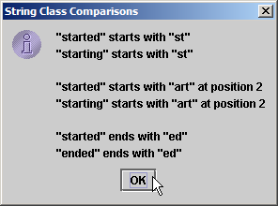
StringStartEnd.java
Line 33
27
28 output += "\n";
29
30 // test method endsWith
31 for ( int count = 0; count < strings.length; count++ )
32
33 if ( strings[ count ].endsWith( "ed" ) )
34 output += "\"" + strings[ count ] + "\" ends with \"ed\"\n";
35
36 JOptionPane.showMessageDialog( null, output,
37 "String Class Comparisons", JOptionPane.INFORMATION_MESSAGE );
38
39 System.exit( 0 );
40 }
41
42 } // end class StringStartEnd
Method endsWith determines if String ends with specified characters

Slide 17
11.3.4 Locating Characters and Substrings in Strings
Search for characters in String
  Method indexOf
    indexOf(char), indexOf(char,start)
    indexOf(string), indexOf(string,start)
  Method lastIndexOf
    lastIndexOf(char), lastIndexOf(char,start)
    lastIndexOf(string), lastIndexOf(string,start)

Slide 18
StringIndexMethods.java
Lines 12-16
Lines 19-26
1 // Fig. 11.5: StringIndexMethods.java
2 // String searching methods indexOf and lastIndexOf.
3 import javax.swing.*;
4
5 public class StringIndexMethods {
6
7 public static void main( String args[] )
8 {
9 String letters = "abcdefghijklmabcdefghijklm";
10
11 // test indexOf to locate a character in a string
12 String output = "'c' is located at index " + letters.indexOf( 'c' );
13
14 output += "\n'a' is located at index " + letters.indexOf( 'a', 1 );
15
16 output += "\n'$' is located at index " + letters.indexOf( '$' );
17
18 // test lastIndexOf to find a character in a string
19 output += "\n\nLast 'c' is located at index " +
20 letters.lastIndexOf( 'c' );
21
22 output += "\nLast 'a' is located at index " +
23 letters.lastIndexOf( 'a', 25 );
24
25 output += "\nLast '$' is located at index " +
26 letters.lastIndexOf( '$' );
27
Method indexOf finds first occurrence of character in String
Method lastIndexOf finds last occurrence of character in String

Slide 19
StringIndexMethods.java
Lines 29-46
28 // test indexOf to locate a substring in a string
29 output += "\n\n\"def\" is located at index " +
30 letters.indexOf( "def" );
31
32 output += "\n\"def\" is located at index " +
33 letters.indexOf( "def", 7 );
34
35 output += "\n\"hello\" is located at index " +
36 letters.indexOf( "hello" );
37
38 // test lastIndexOf to find a substring in a string
39 output += "\n\nLast \"def\" is located at index " +
40 letters.lastIndexOf( "def" );
41
42 output += "\nLast \"def\" is located at index " +
43 letters.lastIndexOf( "def", 25 );
44
45 output += "\nLast \"hello\" is located at index " +
46 letters.lastIndexOf( "hello" );
47
48 JOptionPane.showMessageDialog( null, output,
49 "String searching methods", JOptionPane.INFORMATION_MESSAGE );
50
51 System.exit( 0 );
52 }
53
54 } // end class StringIndexMethods
Methods indexOf and lastIndexOf can also find occurrences of substrings

Slide 20
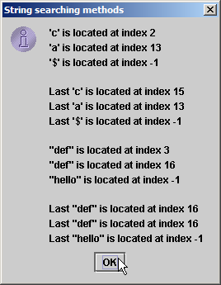
StringIndexMethods.java

Slide 21
11.3.5 Extracting Substrings from Strings
Create Strings from other Strings
  Method substring
    substring(start) (all the way to the end)
    substring(start, first after)

Slide 22
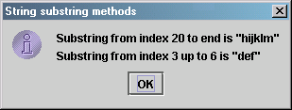
SubString.java
Line 13
Line 16
1 // Fig. 11.6: SubString.java
2 // String class substring methods.
3 import javax.swing.*;
4
5 public class SubString {
6
7 public static void main( String args[] )
8 {
9 String letters = "abcdefghijklmabcdefghijklm";
10
11 // test substring methods
12 String output = "Substring from index 20 to end is " +
13 "\"" + letters.substring( 20 ) + "\"\n";
14
15 output += "Substring from index 3 up to 6 is " +
16 "\"" + letters.substring( 3, 6 ) + "\"";
17
18 JOptionPane.showMessageDialog( null, output,
19 "String substring methods", JOptionPane.INFORMATION_MESSAGE );
20
21 System.exit( 0 );
22 }
23
24 } // end class SubString
Beginning at index 20, extract characters from String letters
Extract characters from index 3 to 6 from String letters

Slide 23
11.3.6 Concatenating Strings
Method concat
  Concatenate two String objects
    s1.concat( s2 )

Slide 24
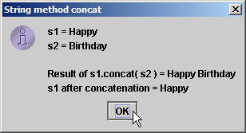
StringConcatenation.java
Line 14
Line 15
1 // Fig. 11.7: StringConcatenation.java
2 // String concat method.
3 import javax.swing.*;
4
5 public class StringConcatenation {
6
7 public static void main( String args[] )
8 {
9 String s1 = new String( "Happy " );
10 String s2 = new String( "Birthday" );
11
12 String output = "s1 = " + s1 + "\ns2 = " + s2;
13
14 output += "\n\nResult of s1.concat( s2 ) = " + s1.concat( s2 );
15 output += "\ns1 after concatenation = " + s1;
16
17 JOptionPane.showMessageDialog( null, output,
18 "String method concat", JOptionPane.INFORMATION_MESSAGE );
19
20 System.exit( 0 );
21 }
22
23 } // end class StringConcatenation
Concatenate String s2 to String s1
However, String s1 is not modified by method concat

Slide 25
11.3.7 Miscellaneous String Methods
Miscellaneous String methods
  Return modified copies of String
    replace(char,char)
    toUpperCase()
    toLowerCase()
    trim() (remove all white space from beginning and end of string)
  Return character array
    toCharArray()

Slide 26
StringMiscellaneous2.java
Line 17
Line 20
Line 21
Line 24
1 // Fig. 11.8: StringMiscellaneous2.java
2 // String methods replace, toLowerCase, toUpperCase, trim and toCharArray.
3 import javax.swing.*;
4
5 public class StringMiscellaneous2 {
6
7 public static void main( String args[] )
8 {
9 String s1 = new String( "hello" );
10 String s2 = new String( "GOODBYE" );
11 String s3 = new String( " spaces " );
12
13 String output = "s1 = " + s1 + "\ns2 = " + s2 + "\ns3 = " + s3;
14
15 // test method replace
16 output += "\n\nReplace 'l' with 'L' in s1: " +
17 s1.replace( 'l', 'L' );
18
19 // test toLowerCase and toUpperCase
20 output += "\n\ns1.toUpperCase() = " + s1.toUpperCase() +
21 "\ns2.toLowerCase() = " + s2.toLowerCase();
22
23 // test trim method
24 output += "\n\ns3 after trim = \"" + s3.trim() + "\"";
25
Use method replace to return s1 copy in which every occurrence of ‘l’ is replaced with ‘L’
Use method toUpperCase to return s1 copy in which every character is uppercase
Use method toLowerCase to return s2 copy in which every character is uppercase
Use method trim to return s3 copy in which whitespace is eliminated

Slide 27
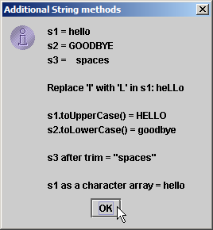
StringMiscellaneous2.java
Line 27
26 // test toCharArray method
27 char charArray[] = s1.toCharArray();
28 output += "\n\ns1 as a character array = ";
29
30 for ( int count = 0; count < charArray.length; ++count )
31 output += charArray[ count ];
32
33 JOptionPane.showMessageDialog( null, output,
34 "Additional String methods", JOptionPane.INFORMATION_MESSAGE );
35
36 System.exit( 0 );
37 }
38
39 } // end class StringMiscellaneous2
Use method toCharArray to return character array of s1

Slide 28
11.3.8 String Method valueOf
String provides static class methods
  Method valueOf
    Returns String representation of object, data, etc.
    toString cannot be used with primitives, but valueOf can

Slide 29
StringValueOf.java
Lines 20-26
1 // Fig. 11.9: StringValueOf.java
2 // String valueOf methods.
3 import javax.swing.*;
4
5 public class StringValueOf {
6
7 public static void main( String args[] )
8 {
9 char charArray[] = { 'a', 'b', 'c', 'd', 'e', 'f' };
10 boolean booleanValue = true;
11 char characterValue = 'Z';
12 int integerValue = 7;
13 long longValue = 10000000L;
14 float floatValue = 2.5f; // f suffix indicates that 2.5 is a float
15 double doubleValue = 33.333;
16 Object objectRef = "hello"; // assign string to an Object reference
17
18 String output = "char array = " + String.valueOf( charArray ) +
19 "\npart of char array = " + String.valueOf( charArray, 3, 3 ) +
20 "\nboolean = " + String.valueOf( booleanValue ) +
21 "\nchar = " + String.valueOf( characterValue ) +
22 "\nint = " + String.valueOf( integerValue ) +
23 "\nlong = " + String.valueOf( longValue ) +
24 "\nfloat = " + String.valueOf( floatValue ) +
25 "\ndouble = " + String.valueOf( doubleValue ) +
26 "\nObject = " + String.valueOf( objectRef );
static method valueOf of class String returns String representation of various types

Slide 30
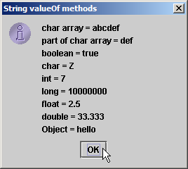
StringValueOf.java
27
28 JOptionPane.showMessageDialog( null, output,
29 "String valueOf methods", JOptionPane.INFORMATION_MESSAGE );
30
31 System.exit( 0 );
32 }
33
34 } // end class StringValueOf

Slide 31
11.4 Class StringBuffer
Class StringBuffer
  When String object is created, its contents cannot change
  StringBuffer used for creating and manipulating dynamic string data
    i.e., modifiable Strings
  Can store characters based on capacity
    Capacity expands dynamically to handle additional characters
  Uses operators + and += for String concatenation

Slide 32
11.4.1 StringBuffer Constructors
Three StringBuffer constructors
  Default creates StringBuffer with no characters
    Capacity of 16 characters
  toString method can be used to convert StringBuffer object into String object

Slide 33
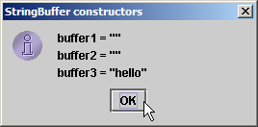
StringBufferConstructors.java
Line 9
Line 10
Line 11
Lines 13-15
1 // Fig. 11.10: StringBufferConstructors.java
2 // StringBuffer constructors.
3 import javax.swing.*;
4
5 public class StringBufferConstructors {
6
7 public static void main( String args[] )
8 {
9 StringBuffer buffer1 = new StringBuffer();
10 StringBuffer buffer2 = new StringBuffer( 10 );
11 StringBuffer buffer3 = new StringBuffer( "hello" );
12
13 String output = "buffer1 = \"" + buffer1.toString() + "\"" +
14 "\nbuffer2 = \"" + buffer2.toString() + "\"" +
15 "\nbuffer3 = \"" + buffer3.toString() + "\"";
16
17 JOptionPane.showMessageDialog( null, output,
18 "StringBuffer constructors", JOptionPane.INFORMATION_MESSAGE );
19
20 System.exit( 0 );
21 }
22
23 } // end class StringBufferConstructors
Default constructor creates empty StringBuffer with capacity of 16 characters
Second constructor creates empty StringBuffer with capacity of specified (10) characters
Third constructor creates StringBuffer with String “hello” and capacity of 21 characters
Method toString returns String representation of StringBuffer

Slide 34
11.4.2 StringBuffer Methods length, capacity, setLength and ensureCapacity
Method length
  Return StringBuffer length
Method capacity
  In general, capacity is 16 characters more than initial string
  Return StringBuffer capacity
Method setLength
  Increase or decrease StringBuffer length
    Characters may be discarded or null characters added
Method ensureCapacity
  Set StringBuffer capacity
  Guarantee that StringBuffer has minimum capacity

Slide 35
StringBufferCapLen.java
Line 12
Line 12
Line 14
Line 17
1 // Fig. 11.11: StringBufferCapLen.java
2 // StringBuffer length, setLength, capacity and ensureCapacity methods.
3 import javax.swing.*;
4
5 public class StringBufferCapLen {
6
7 public static void main( String args[] )
8 {
9 StringBuffer buffer = new StringBuffer( "Hello, how are you?" );
10
11 String output = "buffer = " + buffer.toString() + "\nlength = " +
12 buffer.length() + "\ncapacity = " + buffer.capacity();
13
14 buffer.ensureCapacity( 75 );
15 output += "\n\nNew capacity = " + buffer.capacity();
16
17 buffer.setLength( 10 );
18 output += "\n\nNew length = " + buffer.length() +
19 "\nbuf = " + buffer.toString();
20
21 JOptionPane.showMessageDialog( null, output,
22 "StringBuffer length and capacity Methods",
23 JOptionPane.INFORMATION_MESSAGE );
24
Method length returns StringBuffer length
Method capacity returns StringBuffer capacity
Use method ensureCapacity to set capacity to 75
Use method setLength to set length to 10

Slide 36
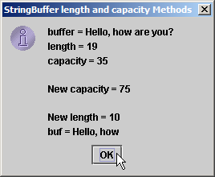
StringBufferCapLen.java
Only 10 characters from StringBuffer are printed
25 System.exit( 0 );
26 }
27
28 } // end class StringBufferCapLen
Only 10 characters from StringBuffer are printed

Slide 37
11.4.3 StringBuffer Methods charAt, setCharAt, getChars and reverse
Manipulating StringBuffer characters
  Method charAt
    Return StringBuffer character at specified index
  Method setCharAt
    Set StringBuffer character at specified index
  Method getChars
    Return character array from StringBuffer
    getChars (start, first after, char array, start)
  Method reverse
    Reverse StringBuffer contents

Slide 38
StringBufferChars.java
Lines 12-13
Line 16
Lines 22-23
1 // Fig. 11.12: StringBufferChars.java
2 // StringBuffer methods charAt, setCharAt, getChars and reverse.
3 import javax.swing.*;
4
5 public class StringBufferChars {
6
7 public static void main( String args[] )
8 {
9 StringBuffer buffer = new StringBuffer( "hello there" );
10
11 String output = "buffer = " + buffer.toString() +
12 "\nCharacter at 0: " + buffer.charAt( 0 ) +
13 "\nCharacter at 4: " + buffer.charAt( 4 );
14
15 char charArray[] = new char[ buffer.length() ];
16 buffer.getChars( 0, buffer.length(), charArray, 0 );
17 output += "\n\nThe characters are: ";
18
19 for ( int count = 0; count < charArray.length; ++count )
20 output += charArray[ count ];
21
22 buffer.setCharAt( 0, 'H' );
23 buffer.setCharAt( 6, 'T' );
24 output += "\n\nbuf = " + buffer.toString();
25
Return StringBuffer characters at indices 0 and 4, respectively
Return character array from StringBuffer
Replace characters at indices 0 and 6 with ‘H’ and ‘T,’ respectively

Slide 39
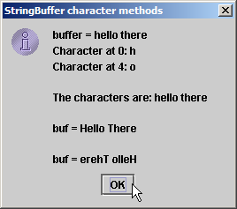
StringBufferChars.java
Lines 26
26 buffer.reverse();
27 output += "\n\nbuf = " + buffer.toString();
28
29 JOptionPane.showMessageDialog( null, output,
30 "StringBuffer character methods",
31 JOptionPane.INFORMATION_MESSAGE );
32
33 System.exit( 0 );
34 }
35
36 } // end class StringBufferChars
Reverse characters in StringBuffer

Slide 40
11.4.4 StringBuffer append Methods
Method append
  Allow data values to be added to the end of a StringBuffer object
  string1 + string2 compiled as StringBuffer(string1).append(string2)
  string1 += string2 compiled as string1 = StringBuffer(string1).append(string2)

Slide 41
StringBufferAppend.java
Line 21
Line 23
Line 25
Line 27
1 // Fig. 11.13: StringBufferAppend.java
2 // StringBuffer append methods.
3 import javax.swing.*;
4
5 public class StringBufferAppend {
6
7 public static void main( String args[] )
8 {
9 Object objectRef = "hello";
10 String string = "goodbye";
11 char charArray[] = { 'a', 'b', 'c', 'd', 'e', 'f' };
12 boolean booleanValue = true;
13 char characterValue = 'Z';
14 int integerValue = 7;
15 long longValue = 10000000;
16 float floatValue = 2.5f; // f suffix indicates 2.5 is a float
17 double doubleValue = 33.333;
18 StringBuffer lastBuffer = new StringBuffer( "last StringBuffer" );
19 StringBuffer buffer = new StringBuffer();
20
21 buffer.append( objectRef );
22 buffer.append( " " ); // each of these contains two spaces
23 buffer.append( string );
24 buffer.append( " " );
25 buffer.append( charArray );
26 buffer.append( " " );
27 buffer.append( charArray, 0, 3 );
Append String “hello” to StringBuffer
Append String “goodbye”
Append “a b c d e f”
Append “a b c”

Slide 42
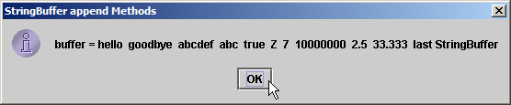
StringBufferAppend.java
Line 29-39
28 buffer.append( " " );
29 buffer.append( booleanValue );
30 buffer.append( " " );
31 buffer.append( characterValue );
32 buffer.append( " " );
33 buffer.append( integerValue );
34 buffer.append( " " );
35 buffer.append( longValue );
36 buffer.append( " " );
37 buffer.append( floatValue );
38 buffer.append( " " );
39 buffer.append( doubleValue );
40 buffer.append( " " );
41 buffer.append( lastBuffer );
42
43 JOptionPane.showMessageDialog( null,
44 "buffer = " + buffer.toString(), "StringBuffer append Methods",
45 JOptionPane.INFORMATION_MESSAGE );
46
47 System.exit( 0 );
48 }
49
50 } // end StringBufferAppend
Append boolean, char, int, long, float and double

Slide 43
11.4.5 StringBuffer Insertion and Deletion Methods
Method insert
  Allow data-type values to be inserted into StringBuffer
  insert (before, object)
Methods delete and deleteCharAt
  Allow characters to be removed from StringBuffer
  delete (start, first after)
  deleteCharAt (index)

Slide 44
StringBufferInsert.java
Lines 20-26
1 // Fig. 11.14: StringBufferInsert.java
2 // StringBuffer methods insert and delete.
3 import javax.swing.*;
4
5 public class StringBufferInsert {
6
7 public static void main( String args[] )
8 {
9 Object objectRef = "hello";
10 String string = "goodbye";
11 char charArray[] = { 'a', 'b', 'c', 'd', 'e', 'f' };
12 boolean booleanValue = true;
13 char characterValue = 'K';
14 int integerValue = 7;
15 long longValue = 10000000;
16 float floatValue = 2.5f; // f suffix indicates that 2.5 is a float
17 double doubleValue = 33.333;
18 StringBuffer buffer = new StringBuffer();
19
20 buffer.insert( 0, objectRef );
21 buffer.insert( 0, " " ); // each of these contains two spaces
22 buffer.insert( 0, string );
23 buffer.insert( 0, " " );
24 buffer.insert( 0, charArray );
25 buffer.insert( 0, " " );
26 buffer.insert( 0, charArray, 3, 3 );
Use method insert to insert data in beginning of StringBuffer

Slide 45
StringBufferInsert.java
Lines 27-38
Line 42
Line 43
27 buffer.insert( 0, " " );
28 buffer.insert( 0, booleanValue );
29 buffer.insert( 0, " " );
30 buffer.insert( 0, characterValue );
31 buffer.insert( 0, " " );
32 buffer.insert( 0, integerValue );
33 buffer.insert( 0, " " );
34 buffer.insert( 0, longValue );
35 buffer.insert( 0, " " );
36 buffer.insert( 0, floatValue );
37 buffer.insert( 0, " " );
38 buffer.insert( 0, doubleValue );
39
40 String output = "buffer after inserts:\n" + buffer.toString();
41
42 buffer.deleteCharAt( 10 ); // delete 5 in 2.5
43 buffer.delete( 2, 6 ); // delete .333 in 33.333
44
45 output += "\n\nbuffer after deletes:\n" + buffer.toString();
46
47 JOptionPane.showMessageDialog( null, output,
48 "StringBuffer insert/delete", JOptionPane.INFORMATION_MESSAGE );
49
50 System.exit( 0 );
51 }
52
53 } // end class StringBufferInsert
Use method insert to insert data in beginning of StringBuffer
Use method deleteCharAt to remove character from index 10 in StringBuffer
Remove characters from indices 2 through 5 (inclusive)

Slide 46
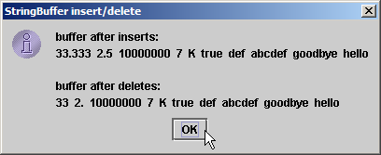
StringBufferInsert.java

Slide 47
11.5 Class Character
Treat primitive variables as objects
  Type wrapper classes
    Boolean
    Character
    Double
    Float
    Byte
    Short
    Integer
    Long
  We examine class Character

Slide 48
StaticCharMethods.java
1 // Fig. 11.15: StaticCharMethods.java
2 // Static Character testing methods and case conversion methods.
3 import java.awt.*;
4 import java.awt.event.*;
5 import javax.swing.*;
6
7 public class StaticCharMethods extends JFrame {
8 private char c;
9 private JLabel promptLabel;
10 private JTextField inputField;
11 private JTextArea outputArea;
12
13 // constructor builds GUI
14 public StaticCharMethods()
15 {
16 super( "Static Character Methods" );
17
18 Container container = getContentPane();
19 container.setLayout( new FlowLayout() );
20
21 promptLabel = new JLabel( "Enter a character and press Enter" );
22 container.add( promptLabel );
23 inputField = new JTextField( 5 );
24

Slide 49
StaticCharMethods.java
25 inputField.addActionListener(
26
27 new ActionListener() { // anonymous inner class
28
29 // handle textfield event
30 public void actionPerformed( ActionEvent event )
31 {
32 String s = event.getActionCommand();
33 c = s.charAt( 0 );
34 buildOutput();
35 }
36
37 } // end anonymous inner class
38
39 ); // end call to addActionListener
40
41 container.add( inputField );
42 outputArea = new JTextArea( 10, 20 );
43 container.add( outputArea );
44
45 setSize( 300, 220 ); // set the window size
46 setVisible( true ); // show the window
47
48 } // end constructor
49

Slide 50
StaticCharMethods.java
Line 54
Line 56
Line 58
Line 59
Line 60
Lines 61-62
50 // display character info in outputArea
51 private void buildOutput()
52 {
53 outputArea.setText( "is defined: " + Character.isDefined( c ) +
54 "\nis digit: " + Character.isDigit( c ) +
55 "\nis first character in a Java identifier: " +
56 Character.isJavaIdentifierStart( c ) +
57 "\nis part of a Java identifier: " +
58 Character.isJavaIdentifierPart( c ) +
59 "\nis letter: " + Character.isLetter( c ) +
60 "\nis letter or digit: " + Character.isLetterOrDigit( c ) +
61 "\nis lower case: " + Character.isLowerCase( c ) +
62 "\nis upper case: " + Character.isUpperCase( c ) +
63 "\nto upper case: " + Character.toUpperCase( c ) +
64 "\nto lower case: " + Character.toLowerCase( c ) );
65 }
66
67 // create StaticCharMethods object to begin execution
68 public static void main( String args[] )
69 {
70 StaticCharMethods application = new StaticCharMethods();
71 application.setDefaultCloseOperation( JFrame.EXIT_ON_CLOSE );
72 }
73
74 } // end class StaticCharMethods
Determine whether c is defined Unicode digit
Determine whether c can be used as first character in identifier
Determine whether c can be used as identifier character
Determine whether c is a letter
Determine whether c is letter or digit
Determine whether c is uppercase or lowercase

Slide 51
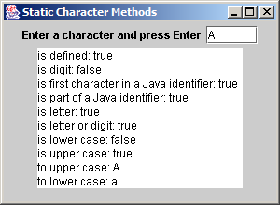
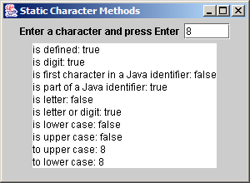
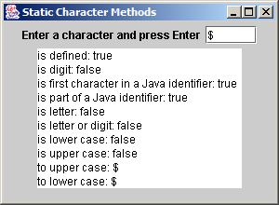
StaticCharMethods.java

Slide 52
11.6 Class StringTokenizer
java.util.StringTokenizer
  Partition String into individual tokens (substrings, words)
  Use delimiter (default is space, tab, newline, return)
  StringTokenizer tokens = new StringTokenizer(addressLine);
  StringTokenizer tokens = new StringTokenizer(addressLine, “ ,;.?!”);
  tokens.countTokens() (number of tokens in the string)
  tokens.nextToken() (return next token)
  tokens.hasMoreTokens() (true or false)

Slide 53
TokenTest.java
Line 24
1 // Fig. 11.18: TokenTest.java
2 // StringTokenizer class.
3 import java.util.*;
4 import java.awt.*;
5 import java.awt.event.*;
6 import javax.swing.*;
7
8 public class TokenTest extends JFrame {
9 private JLabel promptLabel;
10 private JTextField inputField;
11 private JTextArea outputArea;
12
13 // set up GUI and event handling
14 public TokenTest()
15 {
16 super( "Testing Class StringTokenizer" );
17
18 Container container = getContentPane();
19 container.setLayout( new FlowLayout() );
20
21 promptLabel = new JLabel( "Enter a sentence and press Enter" );
22 container.add( promptLabel );
23
24 inputField = new JTextField( 20 );
inputField contains String to be parsed by StringTokenizer

Slide 54
TokenTest.java
Line 33
Line 36
Lines 38-39
25 inputField.addActionListener(
26
27 new ActionListener() { // anonymous inner class
28
29 // handle text field event
30 public void actionPerformed( ActionEvent event )
31 {
32 StringTokenizer tokens =
33 new StringTokenizer( event.getActionCommand() );
34
35 outputArea.setText( "Number of elements: " +
36 tokens.countTokens() + "\nThe tokens are:\n" );
37
38 while ( tokens.hasMoreTokens() )
39 outputArea.append( tokens.nextToken() + "\n" );
40 }
41
42 } // end anonymous inner class
43
44 ); // end call to addActionListener
45
46 container.add( inputField );
47
48 outputArea = new JTextArea( 10, 20 );
49 outputArea.setEditable( false );
50 container.add( new JScrollPane( outputArea ) );
51 setSize( 275, 240 ); // set the window size
52 setVisible( true ); // show the window
53 }
Use StringTokenizer to parse String using default delimiter “ \n\t\r”
Count number of tokens
Append next token to outputArea, as long as tokens exist

Slide 55
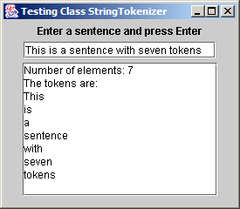
TokenTest.java
54
55 // execute application
56 public static void main( String args[] )
57 {
58 TokenTest application = new TokenTest();
59 application.setDefaultCloseOperation( JFrame.EXIT_ON_CLOSE );
60 }
61
62 } // end class TokenTest

